Slide 1
Maze Mockup interface

Slide 2
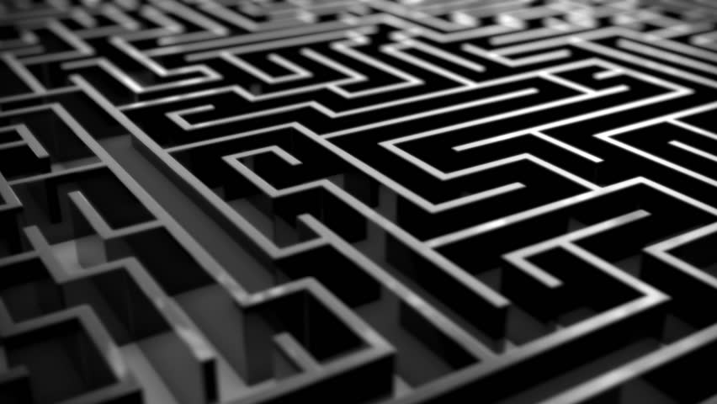
MAZE
New Game
Load Game
Settings
High Scores
Credits
Notes:
Continuous mazes

Slide 3
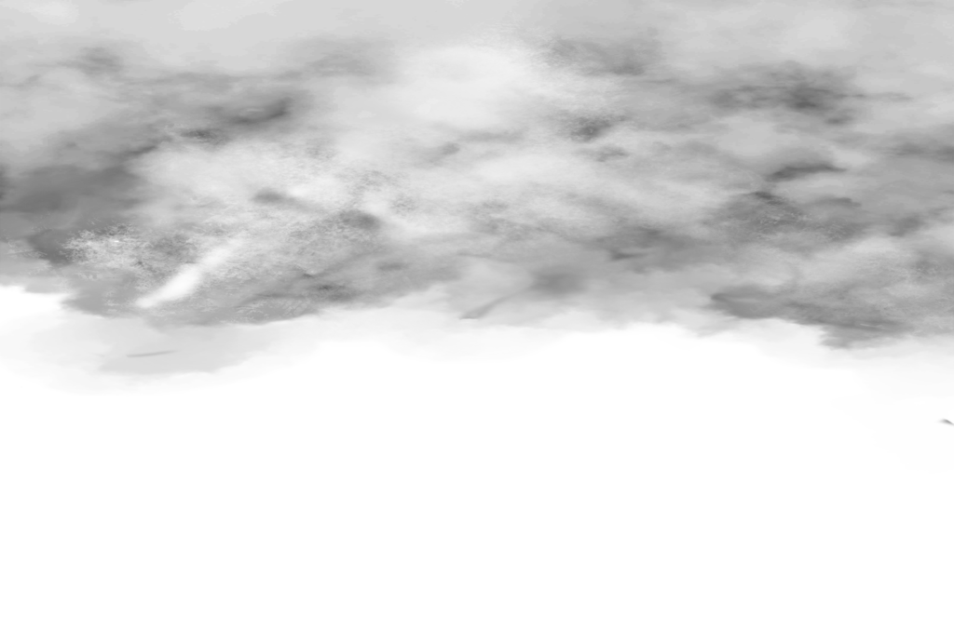
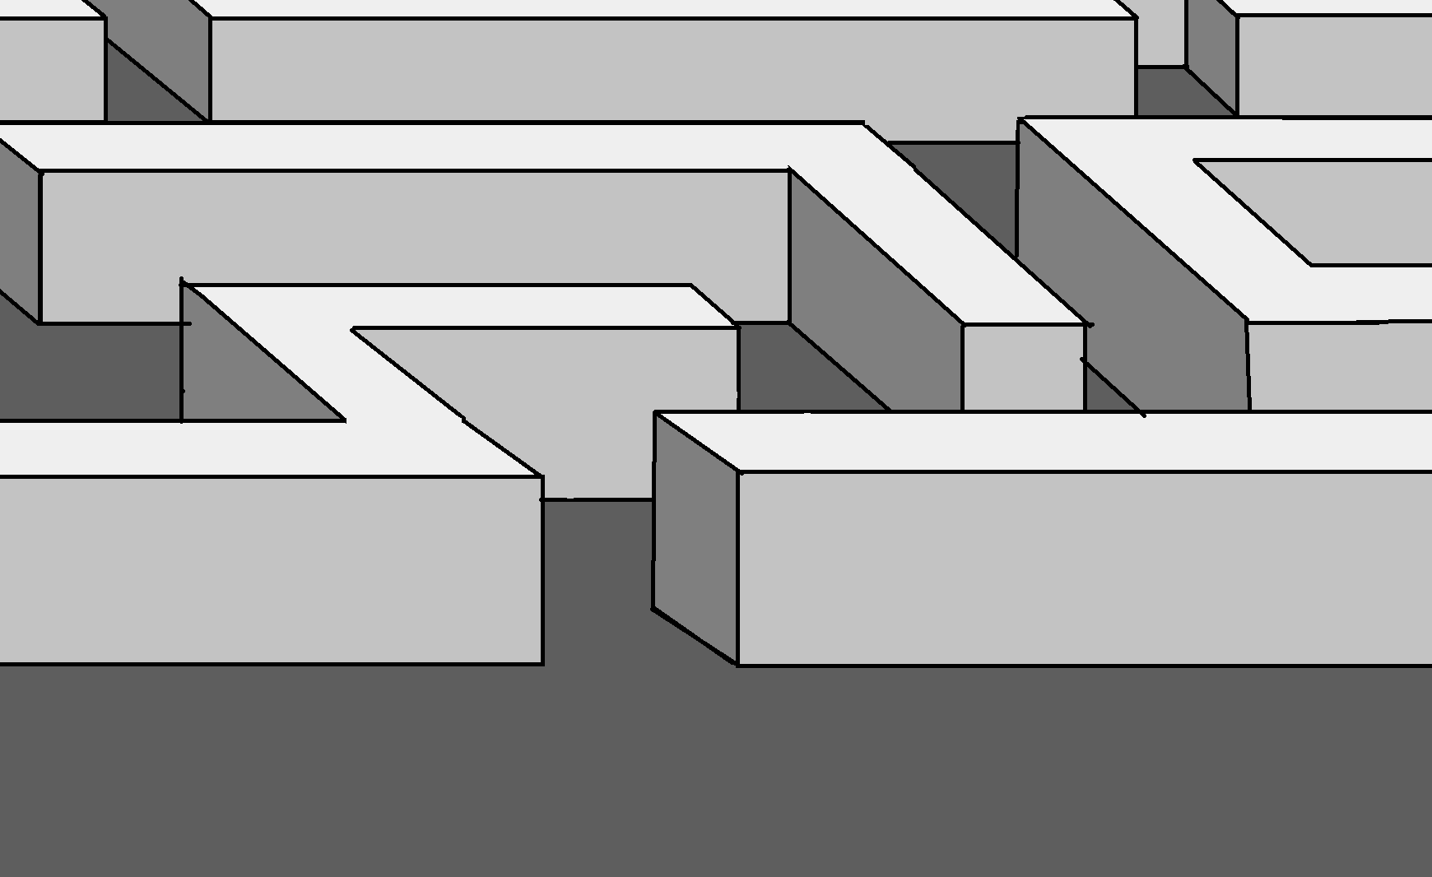

EXIT
Save
Pause
Time: 00:00:01
Score: 0
Notes:
Pause button could have the save option

Slide 4
CONGRATULATIONS!
Score: 54555
Time: 10:05:01
enter name:
Press here to continue

Slide 5
MAZE 1
MAZE 2
MAZE 3
HOME

Slide 6
Save to which slot?
MAZE 1
Time: 00:00:00
Score: 0
MAZE 2
Time: 01:00:00
Score: 50050
MAZE 3
Time: 00:05:00
Score: 750
HOME

Slide 7
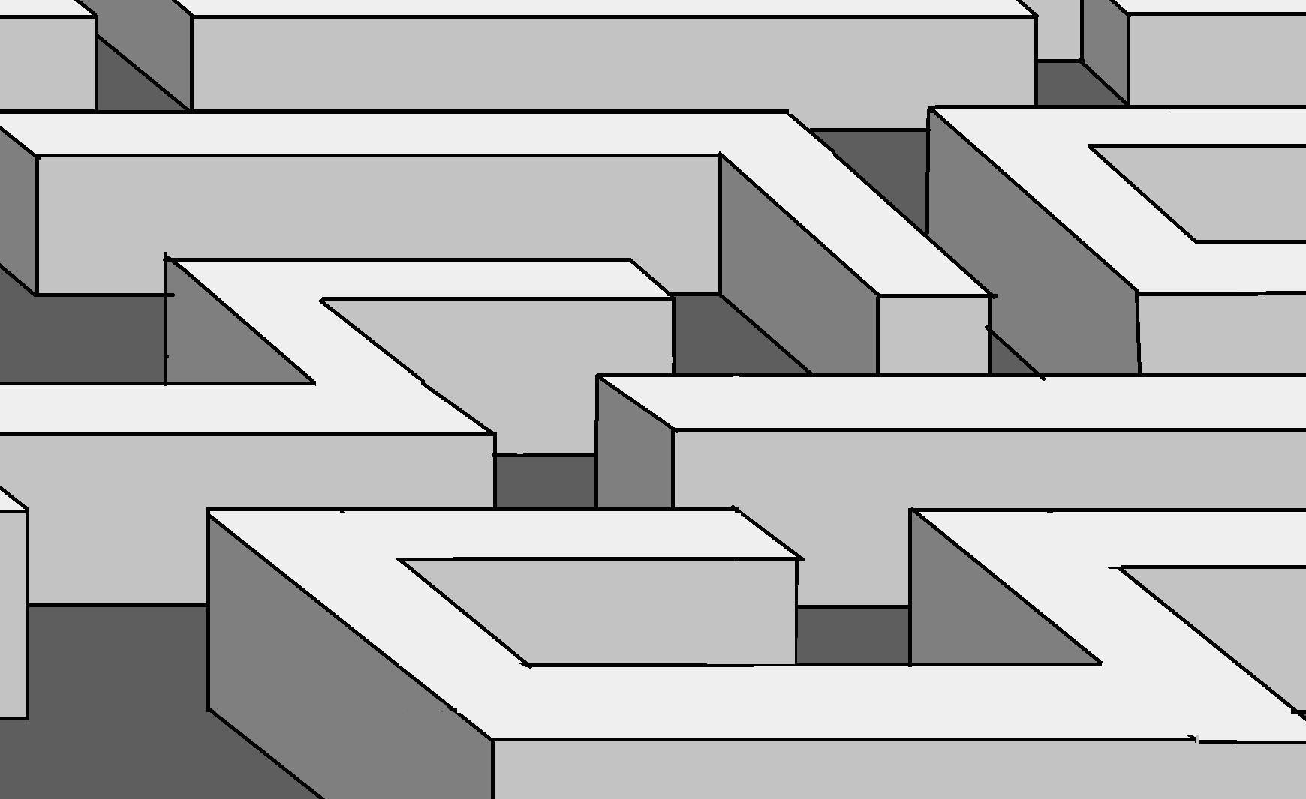
Game 1:
EXIT
Save
Pause
Time: 00:10:01
Score: 100
Notes:
Needs to show what the middle of the maze will look like

Slide 8

Customize Maze
Themes:
Brick
Stone Hedge
Bush
Creepy Dungeon
CUSTOMIZE
WALLS
FLOOR
Buttons
Music:
Creepy Music
Happy Music
No Music
HOME
Notes:
Character Ghosts?

Slide 9
High Scores
Name
OctoCat
mdp2222
MystiqueMae
Nathan4numbers
NOsleepSnorlax
unicorngll
Xxcrazy420xx
Xodystopian
1depression
Horselover1234
3xtr4bl1nd
Pantlessmaniac
Corgibuttox
Didneyworl
Epsteindidnotkms
High score
54654654
6555555
6546543
5543615
5326456
4546654
654465
554153
132552
78468
54646
46515
6463
5445
4586
Time
00:01:45
00:02:50
00:01:00
00:00:55
00:02:00
00:01:00
00:02:00
00:03:45
00:04:50
00:01:12
00:02:13
00:00:59
00:00:10
00:00:25
00:00:35
HOME

Slide 10
Developers
Matthew Pugh
Grace Looney
HOME

